Slide 1








A Data-Driven Approach to Optimise Parameters of a Computational Digital Twin Model in Response to SBRT on MR-Linac
Valentin SEPTIERS, PhD student
France
CMMCA workshop, Daejeon, South Korea
September 27, 2025

Slide 2
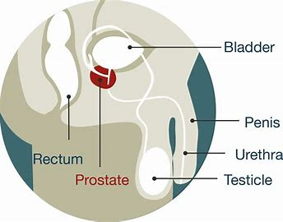
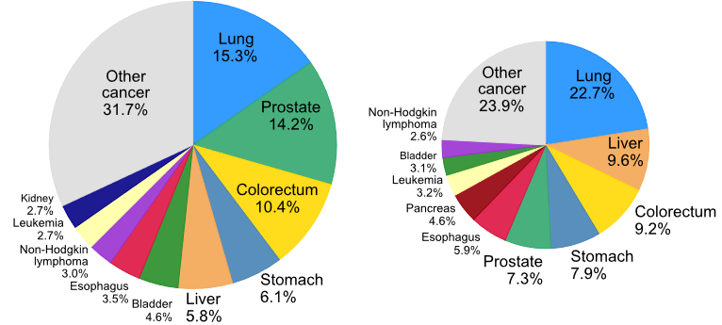
Context
Objectives
Materials & Methods
Results
Future work
Prostate cancer
Frequency
Almost 1.5 million new cases of prostate cancer diagnosed in 2022 worldwide (second most frequent type of cancer in men). In France, most frequent.
Global cancer statistics 2022: GLOBOCAN estimates of incidence and mortality worldwide for 36 cancers in 185 countries, Bray et al. 2024
01/16

Slide 3
Context
Objectives
Materials & Methods
Results
Future work
Prostate cancer
Frequency
Mortality
Almost 1.5 million new cases of prostate cancer diagnosed in 2022 worldwide (second most frequent type of cancer in men). In France, most frequent.
397 000 deaths worldwide (fifth leading cause of cancer death in men). In France, third leading cause.
Global cancer statistics 2022: GLOBOCAN estimates of incidence and mortality worldwide for 36 cancers in 185 countries, Bray et al. 2024
01/16

Slide 4


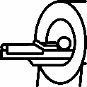
Context
Objectives
Materials & Methods
Results
Future work
Prostate cancer
Biopsies → Gleason Score
Low risk group
Active surveillance
02/16

Slide 5

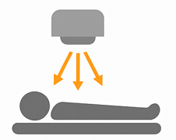
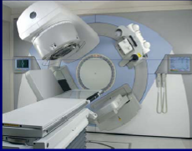
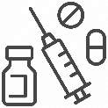
Context
Objectives
Materials & Methods
Results
Future work
Prostate cancer
Biopsies → Gleason Score
Intermediate or high risk groups
Low risk group
Active surveillance
Surgery
(Prostatectomy)
Radiotherapy ($+/−$Hormonotherapy)
60% of patients with intermediate or high risks are treated with radiotherapy
M.C. Joiner and Albert J. van der Kogel. Basic Clinical Radiobiology. 2018. isbn: 978-0-429-95540-2.
02/16

Slide 6

Context
Objectives
Materials & Methods
Results
Future work
Prostate cancer
Biopsies → Gleason Score
Intermediate or high risk groups
Low risk group
Active surveillance
Surgery
(Prostatectomy)
Radiotherapy ($+/−$Hormonotherapy)
60% of patients with intermediate or high risks are treated with radiotherapy
Recurrence rate may reach up to 20% depending on the risk group
M.C. Joiner and Albert J. van der Kogel. Basic Clinical Radiobiology. 2018. isbn: 978-0-429-95540-2.
Zachary S.Zumsteg et al. ‘’Anatomical Patterns of Recurrence Following Biochemical Relapse in the Dose Escalation Era of External Beam Radiotherapy for Prostate Cancer’’. In: The Journal of Urology (2015)
02/16

Slide 7
Context
Objectives
Materials & Methods
Results
Future work
Prostate cancer
Intermediate or high risk groups
Radiotherapy treatments
Radiotherapy
External Beam RadioTherapy (EBRT)
Ionising rays charged with high energy photons are delivered to the tumour
03/16

Slide 8
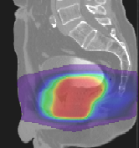
Context
Objectives
Materials & Methods
Results
Future work
Prostate cancer
Intermediate or high risk groups
Radiotherapy treatments
Radiotherapy
Traditional treatment
External Beam RadioTherapy (EBRT)
Planning
Treatment (several weeks)
80 Gy
=
2 Gy
+
2 Gy
+
2 Gy
+
…
N = 40
Ionising rays charged with high energy photons are delivered to the tumour
in fractions
03/16

Slide 9
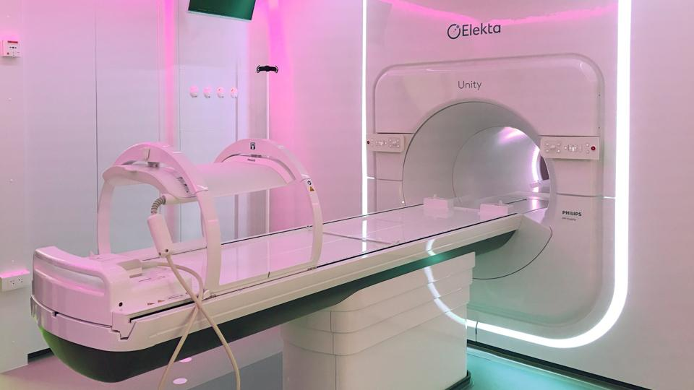
Context
Objectives
Materials & Methods
Results
Future work
Prostate cancer
Intermediate or high risk groups
Radiotherapy treatments
Stereotactic Body RadioTherapy (SBRT) treatment
Planning
SBRT treatment (2 days interval)
40 Gy
=
8 Gy
+
8 Gy
+
8 Gy
+
…
N = 5
De Vries, K. C. et al. In : Int. J. Radiat. Oncol. Biol. Phys. (2020).
03/16

Slide 10
Context
Objectives
Materials & Methods
Results
Future work
MR-Linac
Intermediate or high risk groups
MRI + RT delivery in the same machine
7 MeV linear accelerator of electrons for RT, coupled to 1.5T MRI
In France: first installed in Lyon in 2021, then in Rennes in 2023
MRI acquisitions before, during and after RT session
D.A. Roberts et al. “Machine QA for the Elekta Unity System: A Report from the Elekta MR-linac Consortium”. In: Med. Phy.s (2021).
04/16

Slide 11
Context
Objectives
Materials & Methods
Results
Future work
MR-Linac
Intermediate or high risk groups
MRI + RT delivery in the same machine
7 MeV linear accelerator of electrons for RT, coupled to 1.5T MRI
In France: first installed in Lyon in 2021, then in Rennes in 2023
MRI acquisitions before, during and after RT session
Impact of SBRT still unknown on individual patients with MR-Linac
Risk of recurrence still high for intermediate/high risk patients
D.A. Roberts et al. “Machine QA for the Elekta Unity System: A Report from the Elekta MR-linac Consortium”. In: Med. Phy.s (2021).
04/16

Slide 12
Context
Objectives
Materials & Methods
Results
Future work
MR-Linac
Intermediate or high risk groups
MRI + RT delivery in the same machine
7 MeV linear accelerator of electrons for RT, coupled to 1.5T MRI
In France: first installed in Lyon in 2021, then in Rennes in 2023
MRI acquisitions before, during and after RT session
Impact of SBRT still unknown on individual patients with MR-Linac
Risk of recurrence still high for intermediate/high risk patients
Interest in numerically simulating tumour response to SBRT
D.A. Roberts et al. “Machine QA for the Elekta Unity System: A Report from the Elekta MR-linac Consortium”. In: Med. Phy.s (2021).
04/16

Slide 13

Context
Objectives
Materials & Methods
Results
Future work
Computational digital twin models simulating tumour response to treatments
Simulation of different treatments on infinite virtual tumours or digital twins
05/16

Slide 14
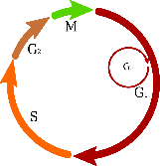

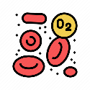


Context
Objectives
Materials & Methods
Results
Future work
Computational digital twin models simulating tumour response to treatments
Simulation of different treatments on infinite virtual tumours or digital twins
Integration of biological mechanisms
05/16

Slide 15
Context
Objectives
Materials & Methods
Results
Future work
Computational digital twin models simulating tumour response to treatments
Simulation of different treatments on infinite virtual tumours or digital twins
Integration of biological mechanisms
Several parameters to adapt specifically to patients
Rely on literature
05/16

Slide 16
Context
Objectives
Materials & Methods
Results
Future work
Computational digital twin models simulating tumour response to treatments
Simulation of different treatments on infinite virtual tumours or digital twins
Integration of biological mechanisms
Several parameters to adapt specifically to patients
Rely on literature
A few models have been validated on patient data
05/16

Slide 17
Context
Objectives
Materials & Methods
Results
Future work
Computational digital twin models simulating tumour response to treatments
Simulation of different treatments on infinite virtual tumours or digital twins
Integration of biological mechanisms
Several parameters to adapt specifically to patients
Rely on literature
A few models have been validated on patient data
No one for SBRT on MR-Linac
05/16

Slide 18
Context
Objectives
Materials & Methods
Results
Future work
Computational digital twin models simulating tumour response to treatments
Simulation of different treatments on infinite virtual tumours or digital twins
Integration of biological mechanisms
Several parameters to adapt specifically to patients
Rely on literature
A few models have been validated on patient data
No one for SBRT on MR-Linac
Computational digital twin model simulating tumour growth and response to RT
Towards a Reduced In Silico Model Predicting Biochemical Recurrence After Radiotherapy in Prostate Cancer, Sosa-Marrero et al. 2021
05/16

Slide 19
Context
Objectives
Materials & Methods
Results
Future work
Objectives
Propose a data-driven approach to optimise the radiobiological parameters of a computational digital twin simulation model in response to SBRT
Computational digital twin model simulating tumour growth and response to RT
Towards a Reduced In Silico Model Predicting Biochemical Recurrence After Radiotherapy in Prostate Cancer, Sosa-Marrero et al. 2021
06/16

Slide 20
Context
Objectives
Materials & Methods
Results
Future work
Objectives
Propose a data-driven approach to optimise the radiobiological parameters of a computational digital twin simulation model in response to SBRT
Identifying patient-specific tumour evolution during SBRT treatment on MR-Linac
Computational digital twin model simulating tumour growth and response to RT
Towards a Reduced In Silico Model Predicting Biochemical Recurrence After Radiotherapy in Prostate Cancer, Sosa-Marrero et al. 2021
06/16

Slide 21
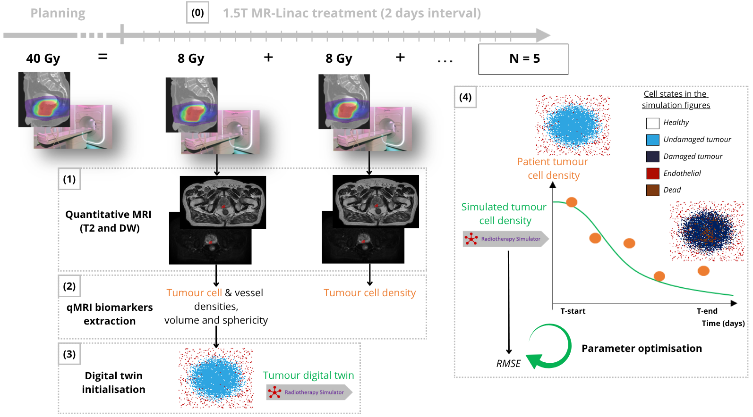

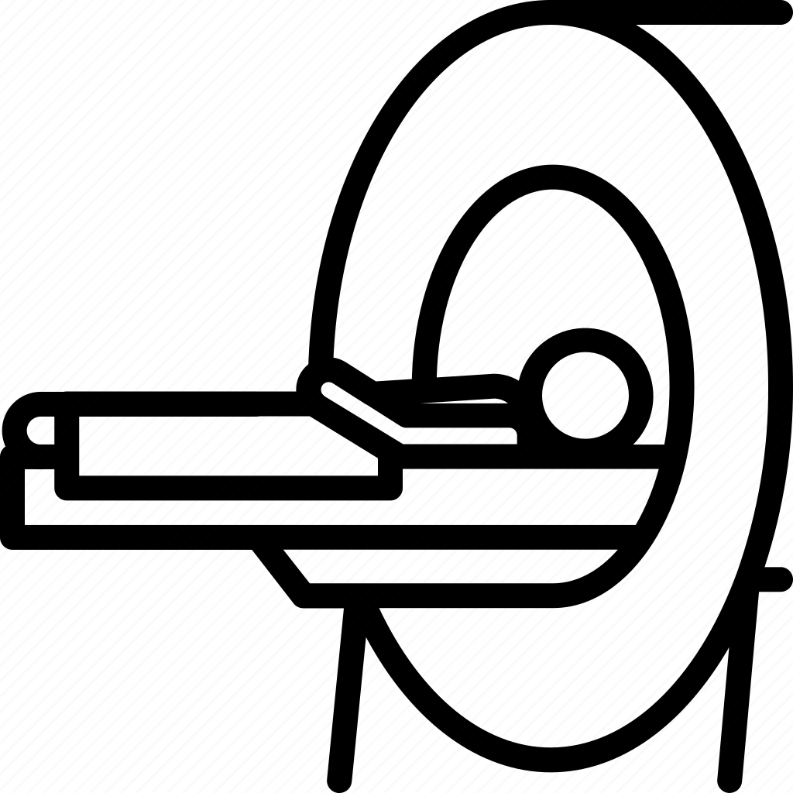
Context
Objectives
Materials & Methods
Results
Future work
Patient data: SBRT treatment
3 intermediate prostate cancer patients (ISUP group 2, mean PSA value : 8.2 ng/mL)
Longitudinal MRI acquisitions
07/16

Slide 22
Context
Objectives
Materials & Methods
Results
Future work
Patient data: Quantitative MRI biomarkers extraction
Radiomics volume and sphericity extraction from T2
=> Pyradiomics
08/16

Slide 23
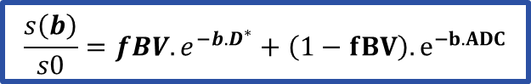
Context
Objectives
Materials & Methods
Results
Future work
Patient data: Quantitative MRI biomarkers extraction
IVIM model applied to DW MRI
$$\frac{s\left(b\right)}{s0}=fBV.e^{−b.D^{∗}}+\left(1−fBV\right).e^{−b.ADC}$$
ADC inside the tumour
Radiomics volume and sphericity extraction from T2
=> Pyradiomics
Tumour cell density
A. Surov, H.J. Meyer, and A. Wienke. “Correlation between Apparent Diffusion Coefficient (ADC) and Cellularity Is Different in Several Tumors: A Meta-Analysis”. In: Oncotarget (2017).
08/16

Slide 24
Context
Objectives
Materials & Methods
Results
Future work
Patient data: Quantitative MRI biomarkers extraction
IVIM model applied to DW MRI
$$\frac{s\left(b\right)}{s0}=fBV.e^{−b.D^{∗}}+\left(1−fBV\right).e^{−b.ADC}$$
ADC inside the tumour
Radiomics volume and sphericity extraction from T2
=> Pyradiomics
Tumour cell density
Vessel density computed from DW MRI
G.-W. Hu et al. “Usefulness of Diffusion Derived Vessel Density Computed from a Simplified IVIM Imaging Protocol: An Experimental Study with Rat Biliary Duct Blockage Induced Liver Fibrosis”. In: J. Magn. Reson. Imaging (2021).
A. Surov, H.J. Meyer, and A. Wienke. “Correlation between Apparent Diffusion Coefficient (ADC) and Cellularity Is Different in Several Tumors: A Meta-Analysis”. In: Oncotarget (2017).
08/16

Slide 25
Context
Objectives
Materials & Methods
Results
Future work
Patient data: Digital twins construction
Computational digital twin model simulating tumour response to SBRT
09/16

Slide 26
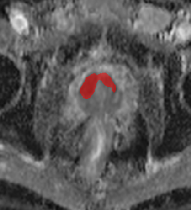
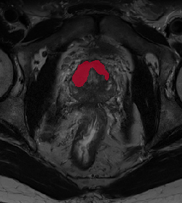
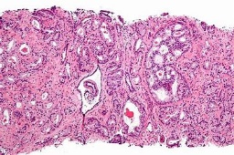
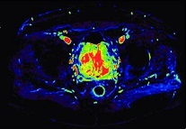
Context
Objectives
Materials & Methods
Results
Future work
Computational digital twin model
Simulation of tumour growth and response to RT
Tumour
delineation
Digital twins construction from multi-source data
Towards a Reduced In Silico Model Predicting Biochemical Recurrence After Radiotherapy in Prostate Cancer, Sosa-Marrero et al. 2021
A Multiformalism and Multiresolution Modelling Environment: Application to the Cardiovascular System and its Regulation, Hernández et al. 2009
10/16

Slide 27
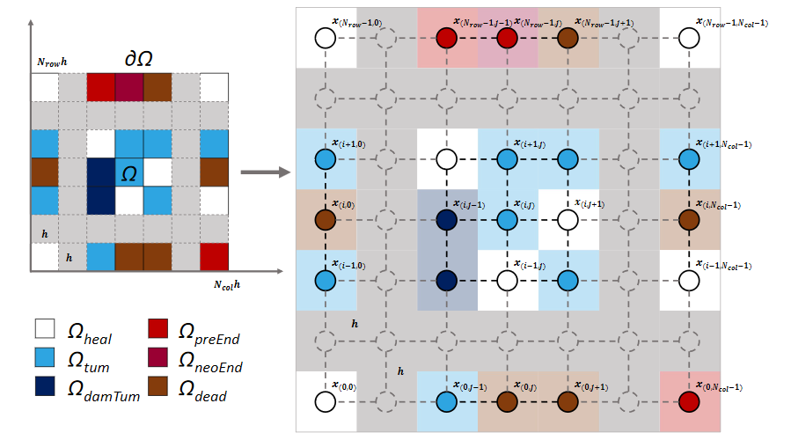

Context
Objectives
Materials & Methods
Results
Future work
Computational digital twin model
Simulation of tumour growth and response to RT
Tumour
delineation
Digital twins construction from multi-source data
Towards a Reduced In Silico Model Predicting Biochemical Recurrence After Radiotherapy in Prostate Cancer, Sosa-Marrero et al. 2021
A Multiformalism and Multiresolution Modelling Environment: Application to the Cardiovascular System and its Regulation, Hernández et al. 2009
10/16

Slide 28
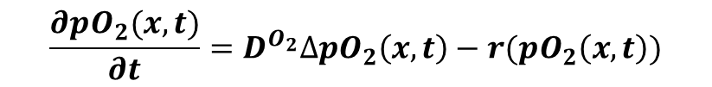
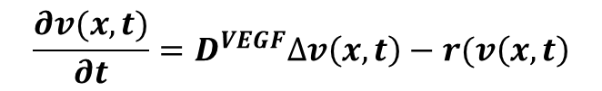
Context
Objectives
Materials & Methods
Results
Future work
Computational digital twin model
Simulation of tumour growth and response to RT
Reaction-diffusion equations
Tumour
delineation
Digital twins construction from multi-source data
$$\frac{∂pO_{2}(x,t)}{∂t}=D^{O_{2}}∆pO_{2}\left(x,t\right)−r(pO_{2}\left(x,t\right))$$
Oxygenation
Angiogenesis
$$\frac{∂v(x,t)}{∂t}=D^{VEGF}∆v\left(x,t\right)−r(v\left(x,t\right)$$
Towards a Reduced In Silico Model Predicting Biochemical Recurrence After Radiotherapy in Prostate Cancer, Sosa-Marrero et al. 2021
A Multiformalism and Multiresolution Modelling Environment: Application to the Cardiovascular System and its Regulation, Hernández et al. 2009
10/16

Slide 29

Context
Objectives
Materials & Methods
Results
Future work
Computational digital twin model
Simulation of tumour growth and response to RT
Tumour
delineation
Digital twins construction from multi-source data
Oxygenation
Angiogenesis
Tumor & Healthy
cells division
Towards a Reduced In Silico Model Predicting Biochemical Recurrence After Radiotherapy in Prostate Cancer, Sosa-Marrero et al. 2021
A Multiformalism and Multiresolution Modelling Environment: Application to the Cardiovascular System and its Regulation, Hernández et al. 2009
10/16

Slide 30
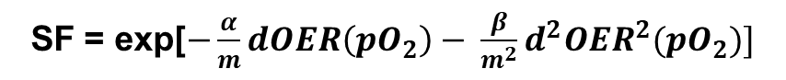
Context
Objectives
Materials & Methods
Results
Future work
Computational digital twin model
Simulation of tumour growth and response to RT
Tumour
delineation
Digital twins construction from multi-source data
Linear Quadratic Model
SF = exp[$−\frac{α}{m}dOER\left(pO_{2}\right)− \frac{β}{m^{2}}d^{2}OER^{2}(pO_{2})]$
Oxygenation
Angiogenesis
Tumor & Healthy
cells division
Response to irradiation
Towards a Reduced In Silico Model Predicting Biochemical Recurrence After Radiotherapy in Prostate Cancer, Sosa-Marrero et al. 2021
A Multiformalism and Multiresolution Modelling Environment: Application to the Cardiovascular System and its Regulation, Hernández et al. 2009
10/16

Slide 31
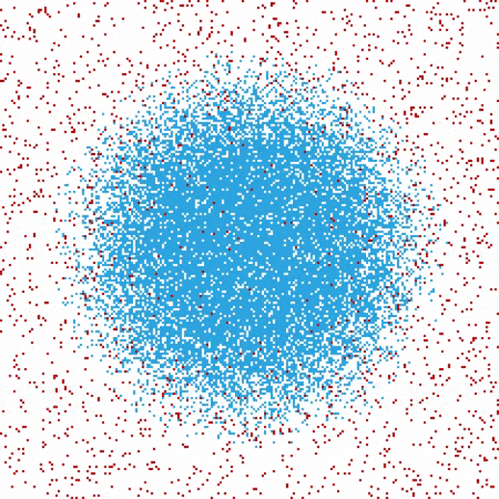
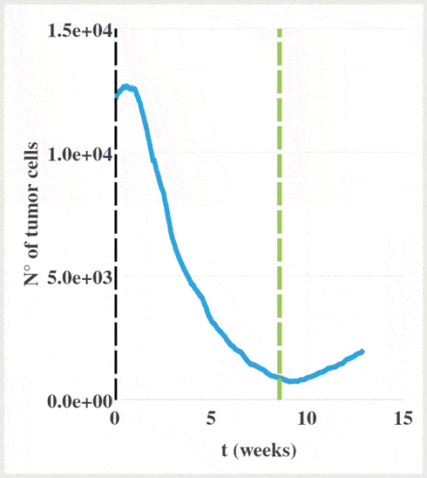
Context
Objectives
Materials & Methods
Results
Future work
Computational digital twin model
In silico simulations of the prescribed treatment
Simulation of tumour growth and response to RT
Tumour
delineation
Digital twins construction from multi-source data
Oxygenation
Angiogenesis
Healthy
Tumor & Healthy
cells division
Response to irradiation
Undamaged tumour
Damaged tumour
Extraction of tumour cell density evolution during SBRT
Endothelial
Dead
Towards a Reduced In Silico Model Predicting Biochemical Recurrence After Radiotherapy in Prostate Cancer, Sosa-Marrero et al. 2021
A Multiformalism and Multiresolution Modelling Environment: Application to the Cardiovascular System and its Regulation, Hernández et al. 2009
10/16

Slide 32
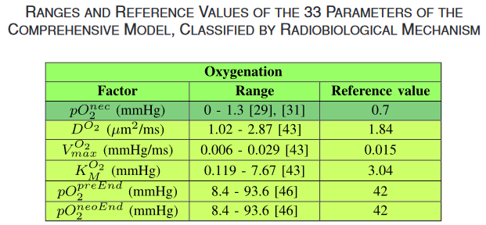
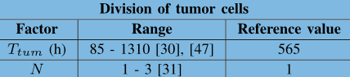
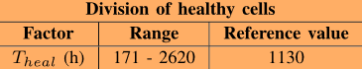
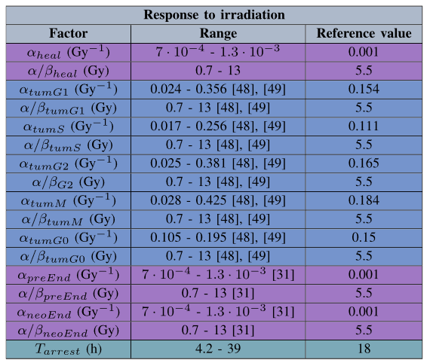
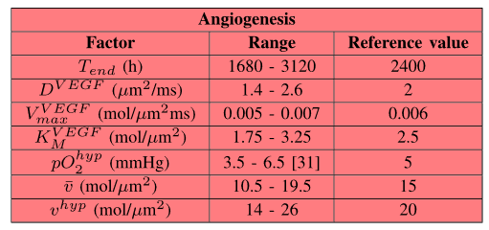
Context
Objectives
Materials & Methods
Results
Future work
Computational digital twin model: Parameters
Towards a Reduced In Silico Model Predicting Biochemical Recurrence After Radiotherapy in Prostate Cancer, Sosa-Marrero et al. 2021
33 parameters !!
11/16

Slide 33
Context
Objectives
Materials & Methods
Results
Future work
Computational digital twin model: Parameters
Towards a Reduced In Silico Model Predicting Biochemical Recurrence After Radiotherapy in Prostate Cancer, Sosa-Marrero et al. 2021
13 parameters to adapt specifically to each patient
Sensitivity analysis
33 parameters !!
α/β
= 1.5
11/16

Slide 34
Context
Objectives
Materials & Methods
Results
Future work
Optimisation of parameters
12/16

Slide 35
Context
Objectives
Materials & Methods
Results
Future work
Optimisation of parameters: Simulated Annealing
Global stochastic optimisation approach
Effective in a large solution space
Operates well on linear or non-linear cost functions
13/16

Slide 36

Context
Objectives
Materials & Methods
Results
Future work
Optimisation of parameters: Simulated Annealing
Global stochastic optimisation approach
Effective in a large solution space
Operates well on linear or non-linear cost functions
Random perturbation of the parameter set
Unstable structure
=> Parameters are changing a lot
13/16

Slide 37

Context
Objectives
Materials & Methods
Results
Future work
Optimisation of parameters: Simulated Annealing
Global stochastic optimisation approach
Effective in a large solution space
Operates well on linear or non-linear cost functions
Random perturbation of the parameter set
Unstable structure
=> Parameters are changing a lot
Stable structure
=> Parameters reaching an ideal solution
13/16

Slide 38
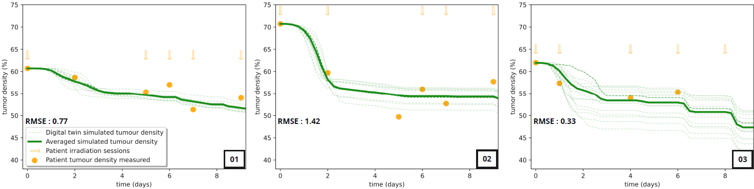
Context
Objectives
Materials & Methods
Results
Future work
14/16

Slide 39
Context
Objectives
Materials & Methods
Results
Future work
Parameters | Patient 01 | Patient 02 | Patient 03
Doubling time of tumour cells (h) | 842 | 1217 | 594
Arrest duration in the cell cycle when irradiated (h) | 10.4 | 38.4 | 31.4
α radiosensitivity parameter in G1 phase (Gy⁻¹) | 0.319 | 0.045 | 0.063
pO₂ of pre existing endothelial cells (mmHg) | 86.93 | 54.21 | 82.97
14/16

Slide 40
Context
Objectives
Materials & Methods
Results
Future work
Parameters | Patient 01 | Patient 02 | Patient 03
Doubling time of tumour cells (h) | 842 | 1217 | 594
Arrest duration in the cell cycle when irradiated (h) | 10.4 | 38.4 | 31.4
α radiosensitivity parameter in G1 phase (Gy⁻¹) | 0.319 | 0.045 | 0.063
pO₂ of pre existing endothelial cells (mmHg) | 86.93 | 54.21 | 82.97
Simulation in accordance with patient’s tumour data measured
Offers insights into the radiobiology of the tumour, even for unobservable parameters
14/16

Slide 41
Context
Objectives
Materials & Methods
Results
Future work
Conclusion
Data-driven approach to estimate the radiobiological parameters of a computational digital twin simulation model in response to SBRT
Identification of patient-specific tumour evolution during SBRT on a 1.5T MR-Linac
Relevance to mimic patient tumour evolution during treatment
15/16

Slide 42
Context
Objectives
Materials & Methods
Results
Future work
Future work
Include other patients in the study (10 patients available now)
Classical LQ model for high doses as in SBRT treatment?
3D-based digital twins may be used (suitable for optimisation process?)
Segmentation uncertainty
16/16

Slide 43
A Data-Driven Approach to Optimise Parameters of a Computational Digital Twin Model in Response to SBRT on MR-Linac
Questions?
CMMCA workshop, Daejeon, South Korea
September 27, 2025

